Slide 1



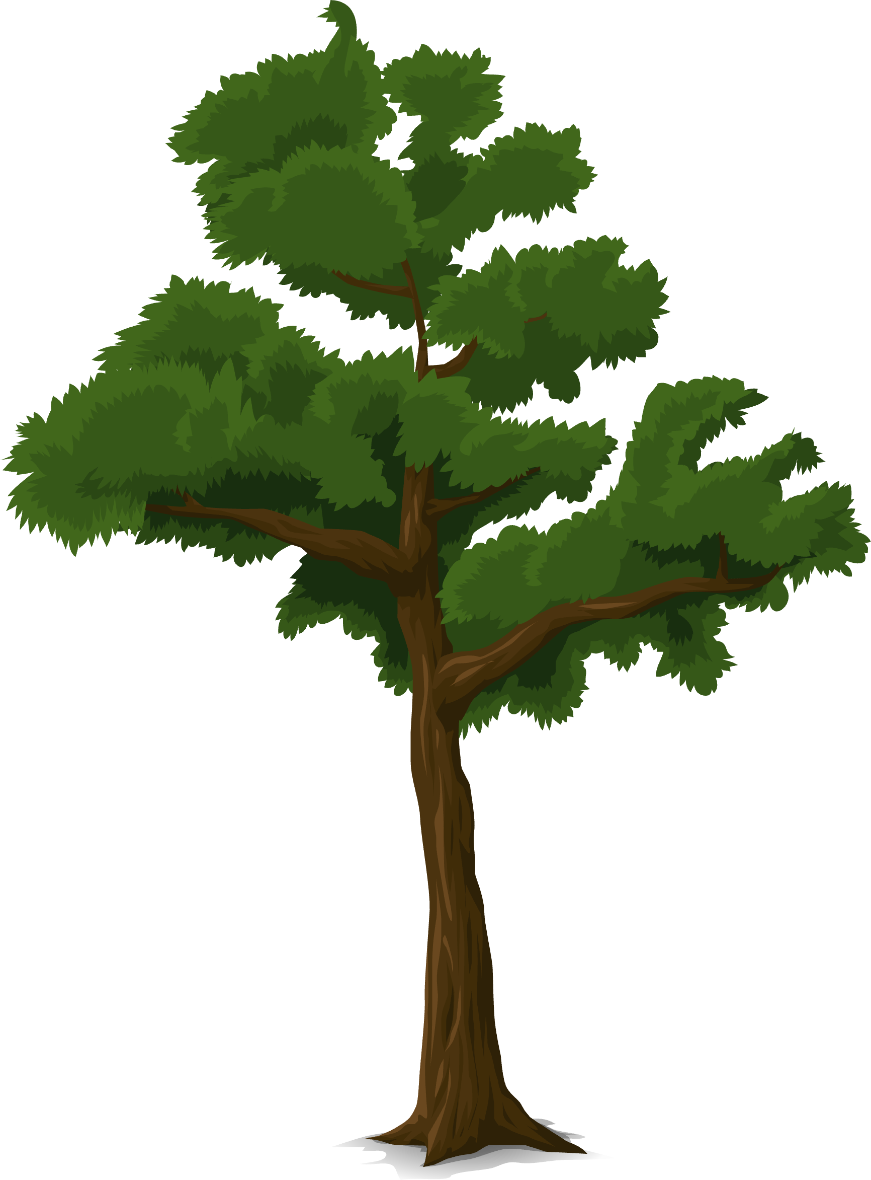






GREEN GUARDIANS OF STABILIZATION
initiative
Presented by Barbara Kyeremaa Asamoah

Slide 2


Objectives
Problem Statement: The youth and children in Burkina Faso who make up 45% of the population are facing multiple insecurities in several communes, including desertification and climate change, which have led to a lack of basic services and loss of livelihood opportunities. This has been exacerbated by the ongoing crisis in the Sahel region, resulting in limited opportunities and the threat of violent extremism and instability.
Solution
Impact: Why trees? Why Now?
Providing immediate stabilization and recovery to 2000 young people and over 1000 children through the tree planting initiative.
Environmental
Social empowerment
Community Resillience
Trees combat desertification, improve soil quality, and restore local ecosystems, creating a sustainable environment for future generations.
Involving marginalized youth in meaningful work has an equipping them with valuable skills, education, and a sense of purpose. This approach plays a crucial role inalso providing basic services for children.
Investing in strong, green communities can have a significant impact by reducing their vulnerability to violence and radicalization.

Slide 3

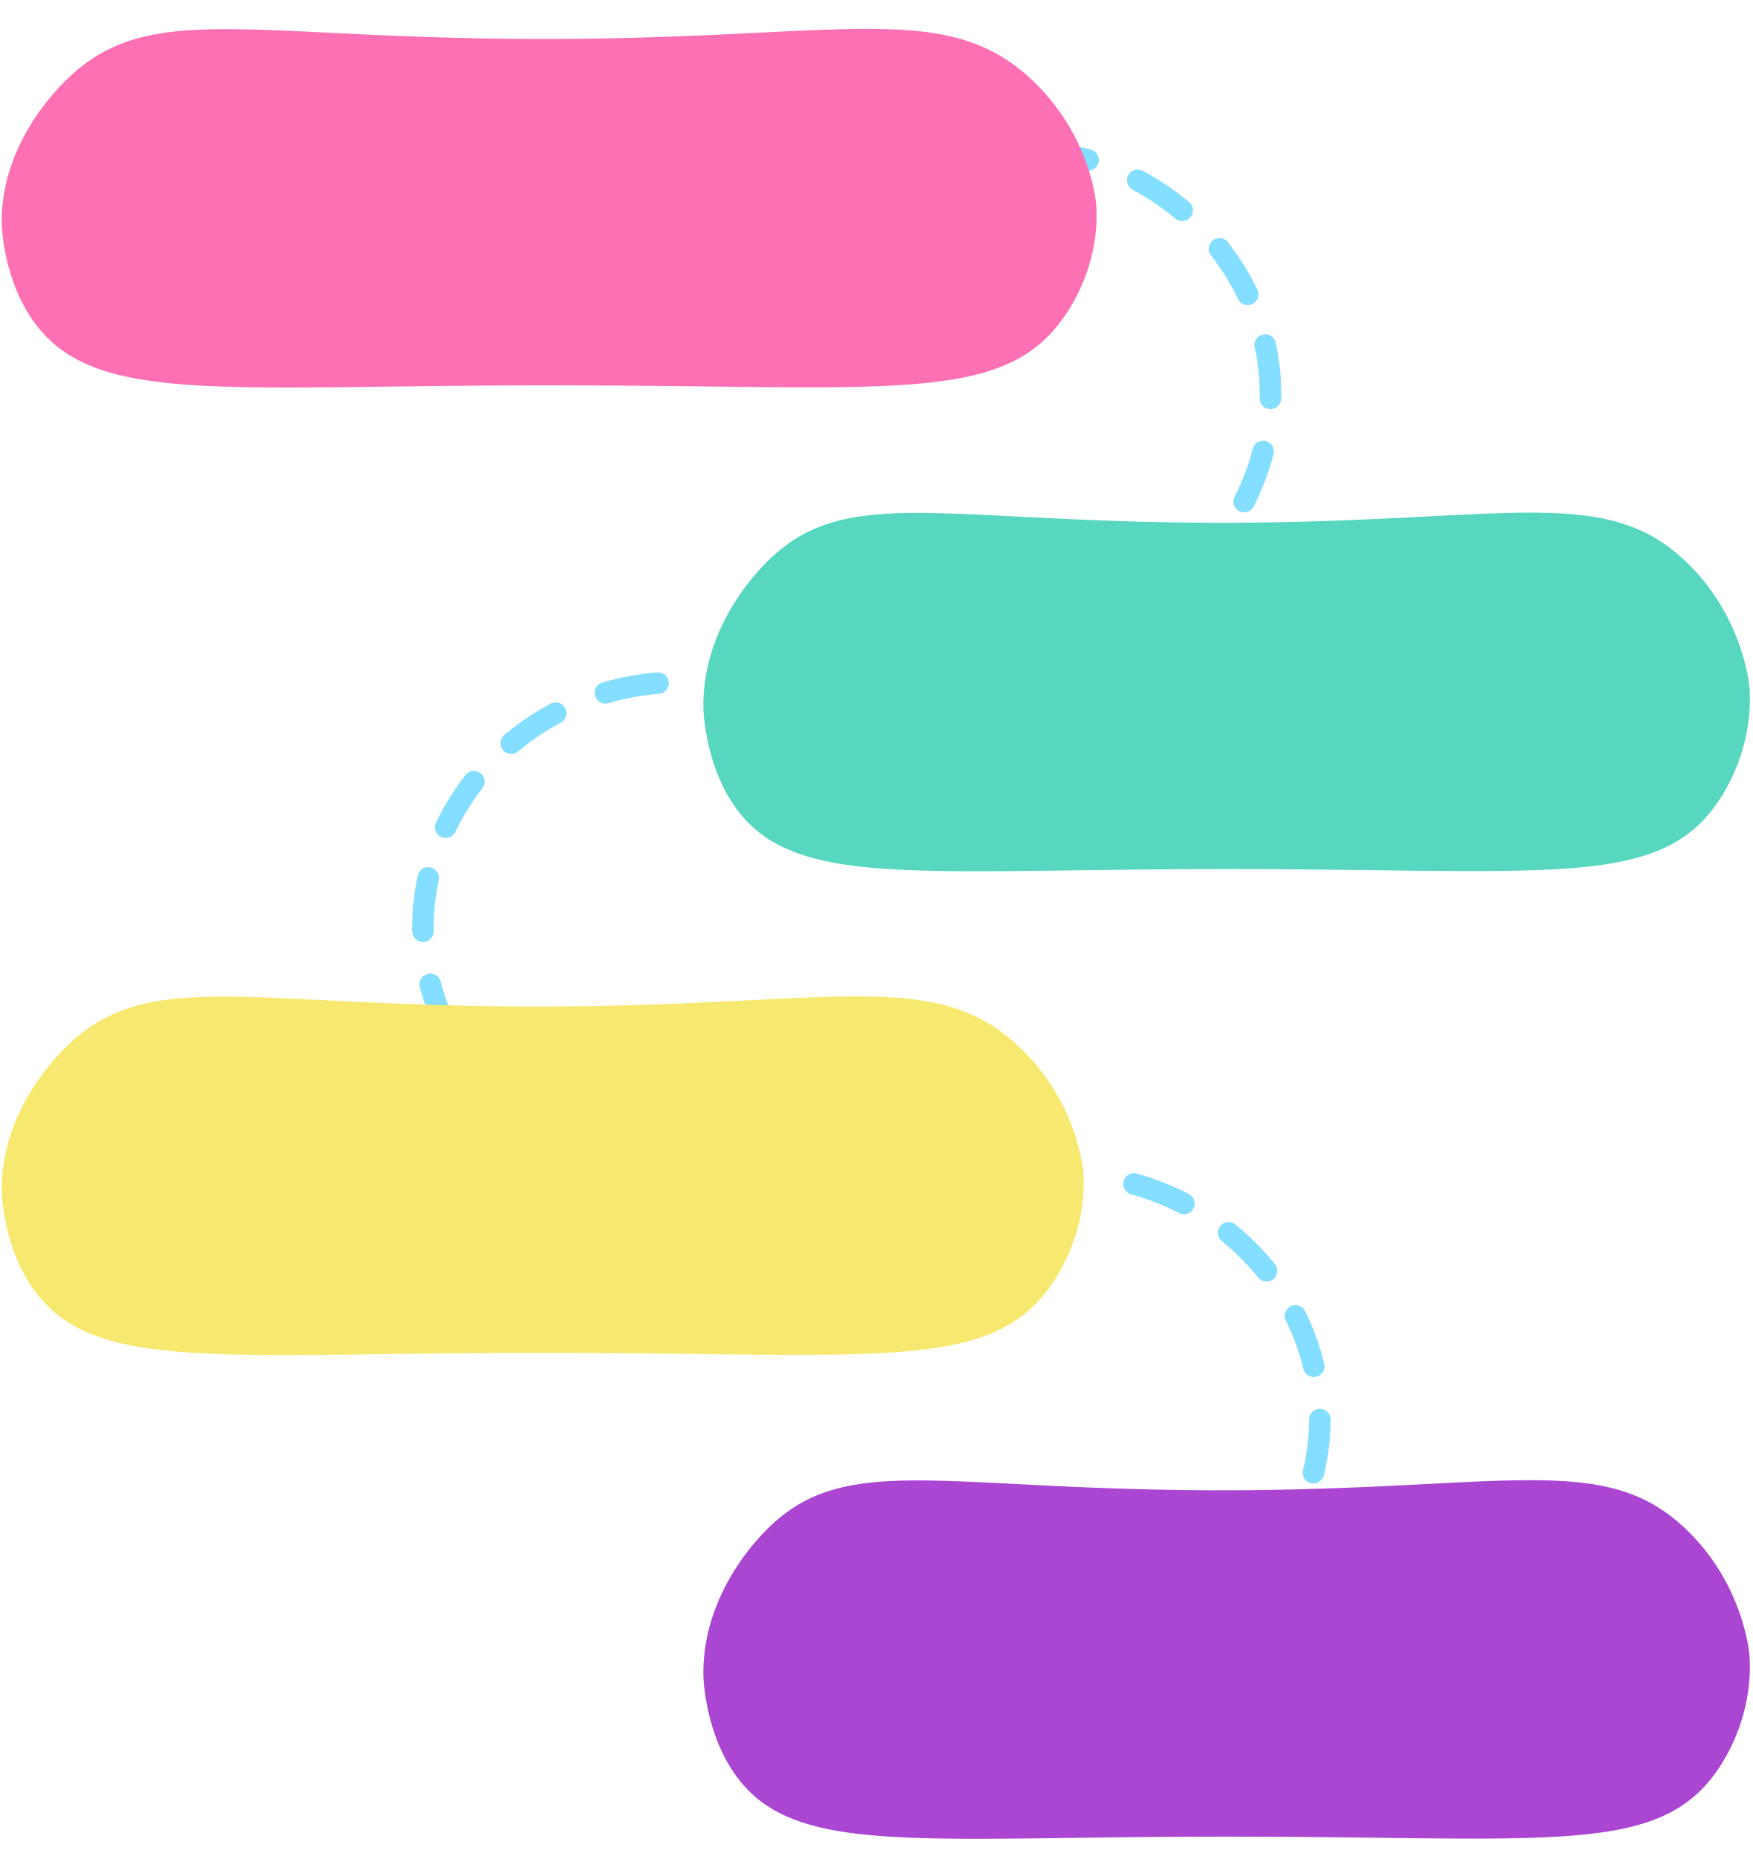
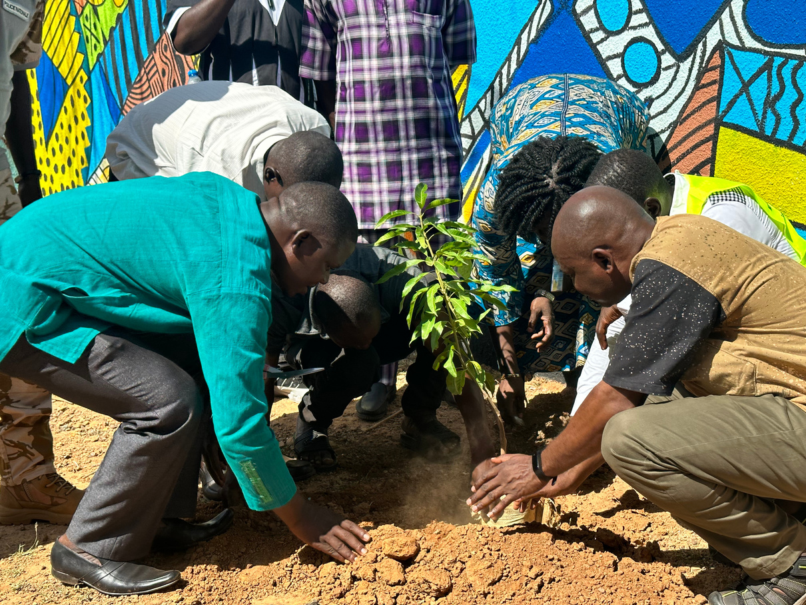
Timeline
PREPARATION CAMPAIGN LAUNCH
SEPTEMBER 2024
CAMPAIGN LAUNCH
OCTOBER 2024
CAMPAIGN
OCTOBER - DECEMBER 2024
POST CAMPAIGN/
ACTIVITY
FEBRUARY 2025

Slide 4

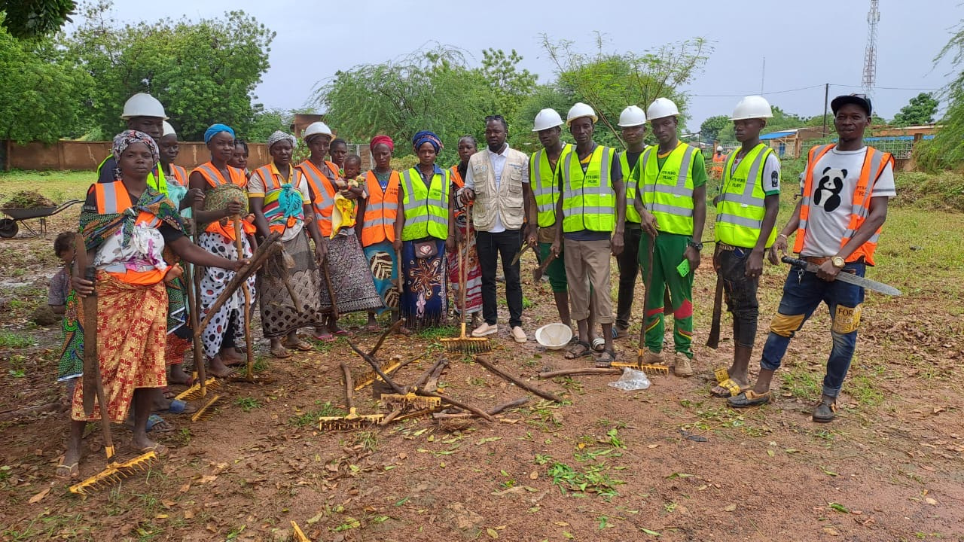

HUMAN STORY
“Following the attacks, the entire village population moved to other localities in Burkina Faso but also in Niger. In the attack, we lost everything in terms of livelihood, which was small businesses and our small ruminants. After a few months spent in these localities the sites of displaced people in very precarious conditions, we are unable to go back to resettle. We have nothing to do and it is very difficult for me to take care of my five children as the head of the household.”- Story of DIALLO Hadjatou Hama a young mother of five children.

Slide 5
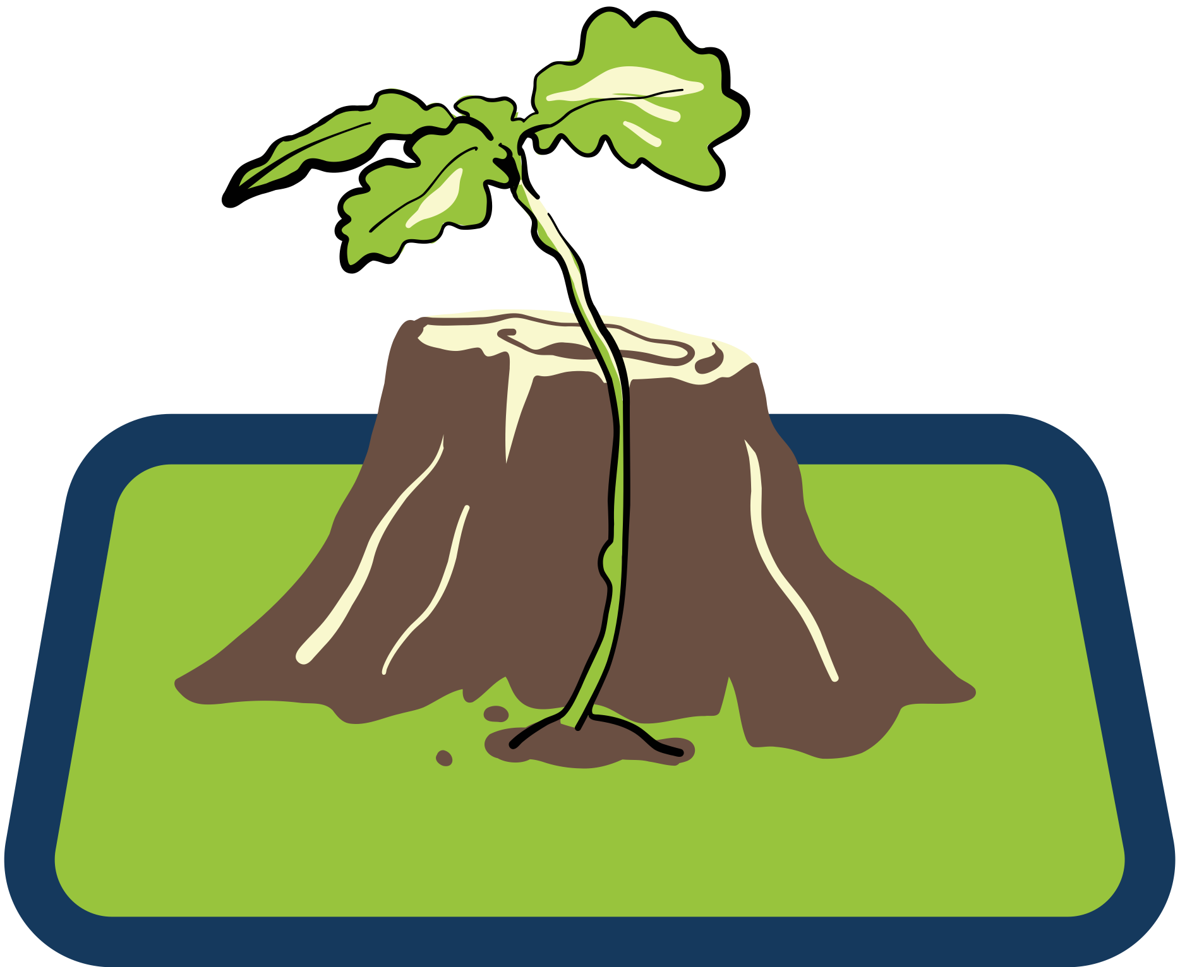
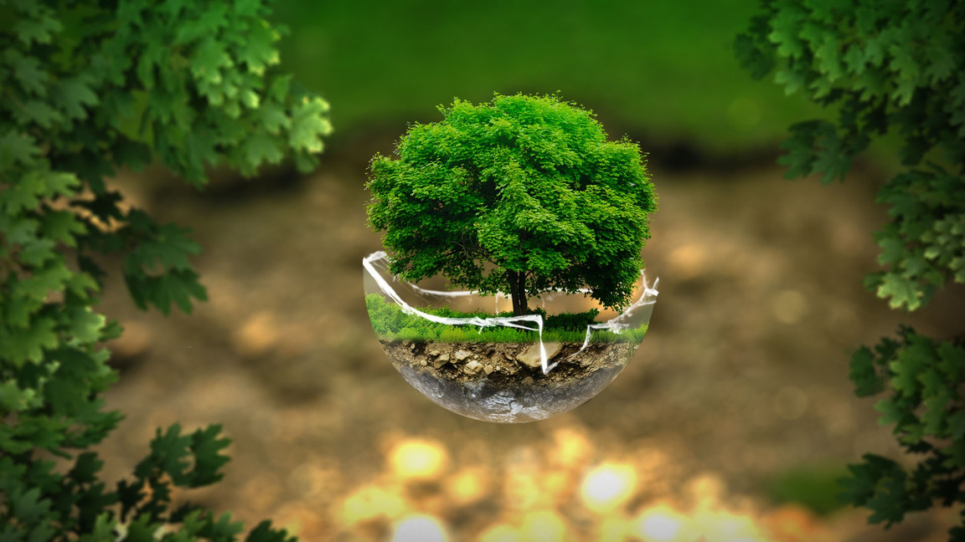

Plant 2000 trees
FUNDRAISING TARGET $ 100 000
Install water point and conervation drums
FUNDRAISING TARGET $ 1 000 000

Slide 6

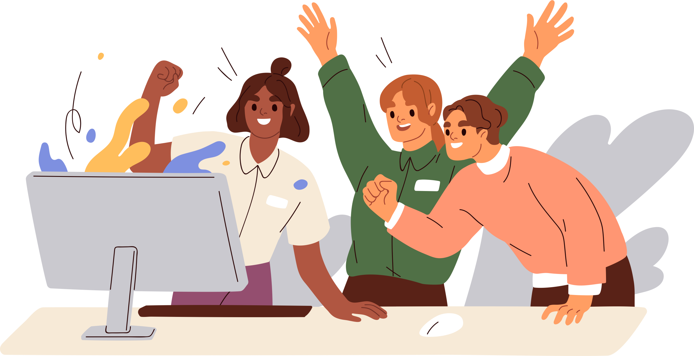
UNDP Burkina Faso Campaign Team
Babara Kyeremaa Asamoah
(Campaign Manager)
Dimitri Zoungrana
Djamilou Dankoro
(Finance Expert)
Burkina Faso Comms Team
Salam Zongo
(Communications)
Ruth Aernouth
Sidi Mahamadi Konfe
Emmanuella Toe
ACCLAB
(Partnerships Managers)
Burkina Faso Comms Team
Salam Zongo
(Social Media Expert)
Joshua Samuel
Caroline Sarr
(Graphic Design/Videography)

Slide 7

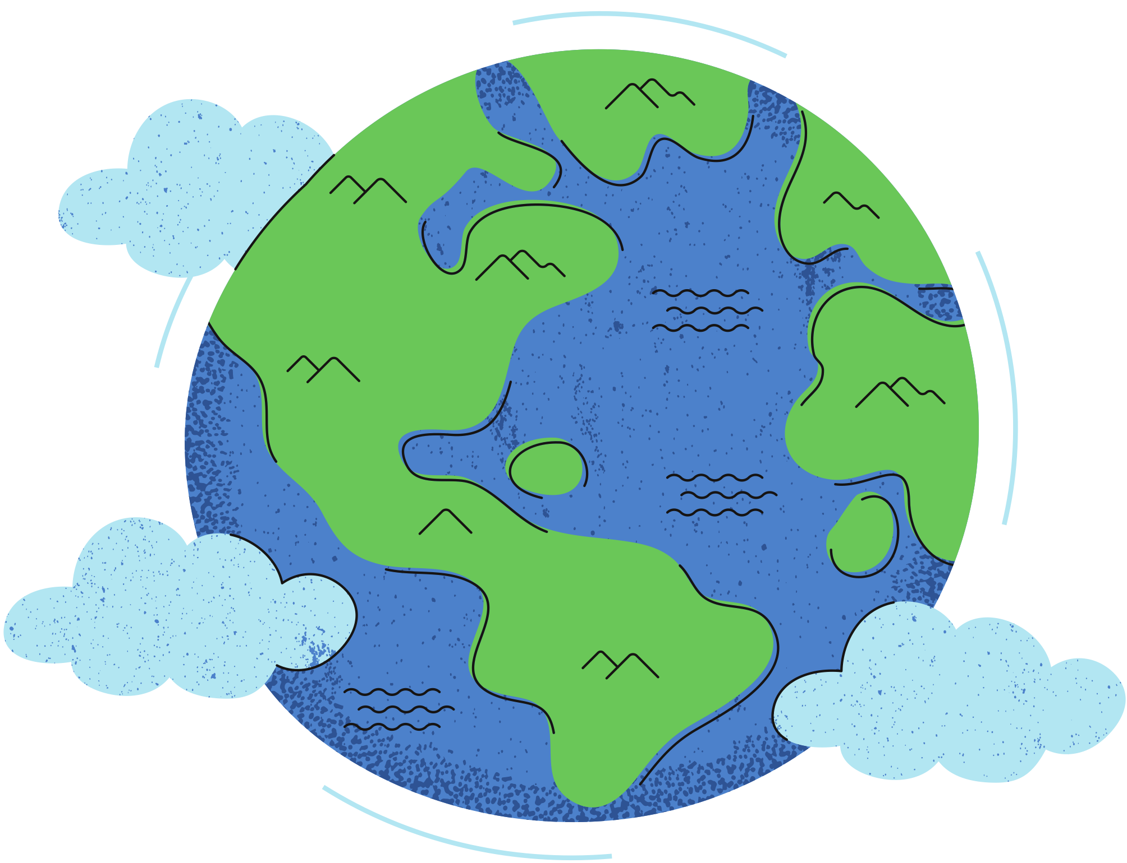
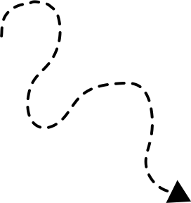

Partnerships Mapping
Type | Name | What will be their role and contribution? ( Are they providing financial, material, intellectual or human resources?)
Private Sector | Orange BFA | Financial
Private Sector | IAMGOLD | Financial
Private Sector | ORANGE FOUNDATION | Financial
Government Institutions | Ministry for territorial development and finance | Intellectual
Government Institutions | Ministry for youth and sports | Intellectual, Material, Human
Government Institutions | Local government for the Northern and Sahel Region | Intellectual, Material, Human
Philanthropic Organizations | EBOMAF foundation | Intellectual,Material
Philanthropic Organizations | Sika Bella Kabore Foundation | Intellectual,Material
Goodwill Ambassadors/ Influencers | Malika Slamazone | Intellectual
Goodwill Ambassadors/ Influencers | Alif Naaba | Intellectual
High-net-worth Individuals | Mahamadou Bonkoungou | Financial, Material
High-net-worth Individuals
Media

Slide 8
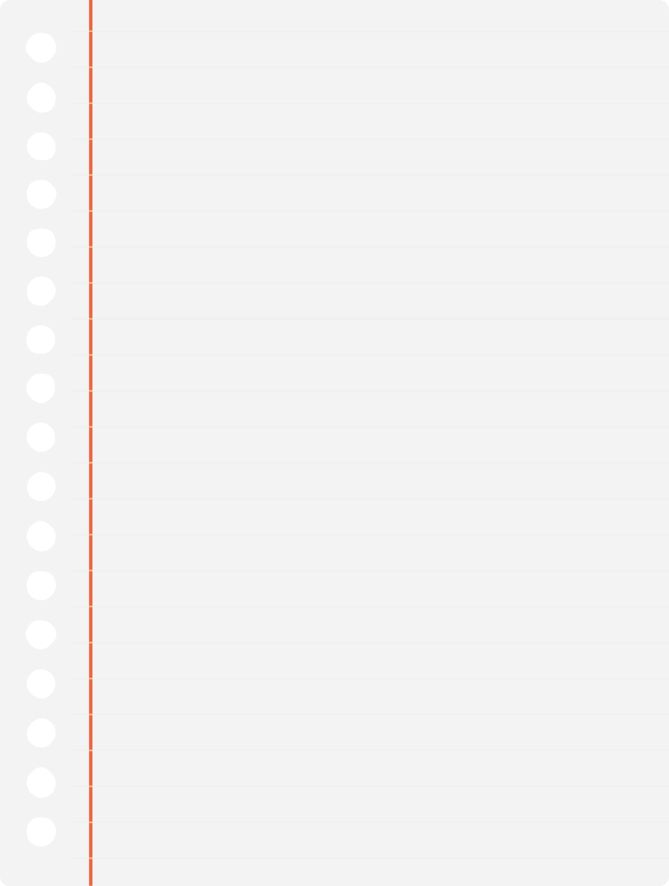


Communication Strategy
Target Audience
Campaign Website
Philantropist
Foundations
Charitable Organisation
Individuals
Private sector
Public sector
Media
GoFundMe
Kickstarter
Classy
Tacticts & Activities
Use goodwill ambassadors to create content, live events,
Use promotional videos
Use tokens and rewards

Slide 9

Call to action: Support 2000 youth green guardians with; $50 $100 for tree-planting kits with an impact token.
SEE THE TOKEN BEHIND EACH AMOUNT
$5-100

Slide 10

VISUALS

Slide 11
Thank you!

